Slide 1


Slide 2

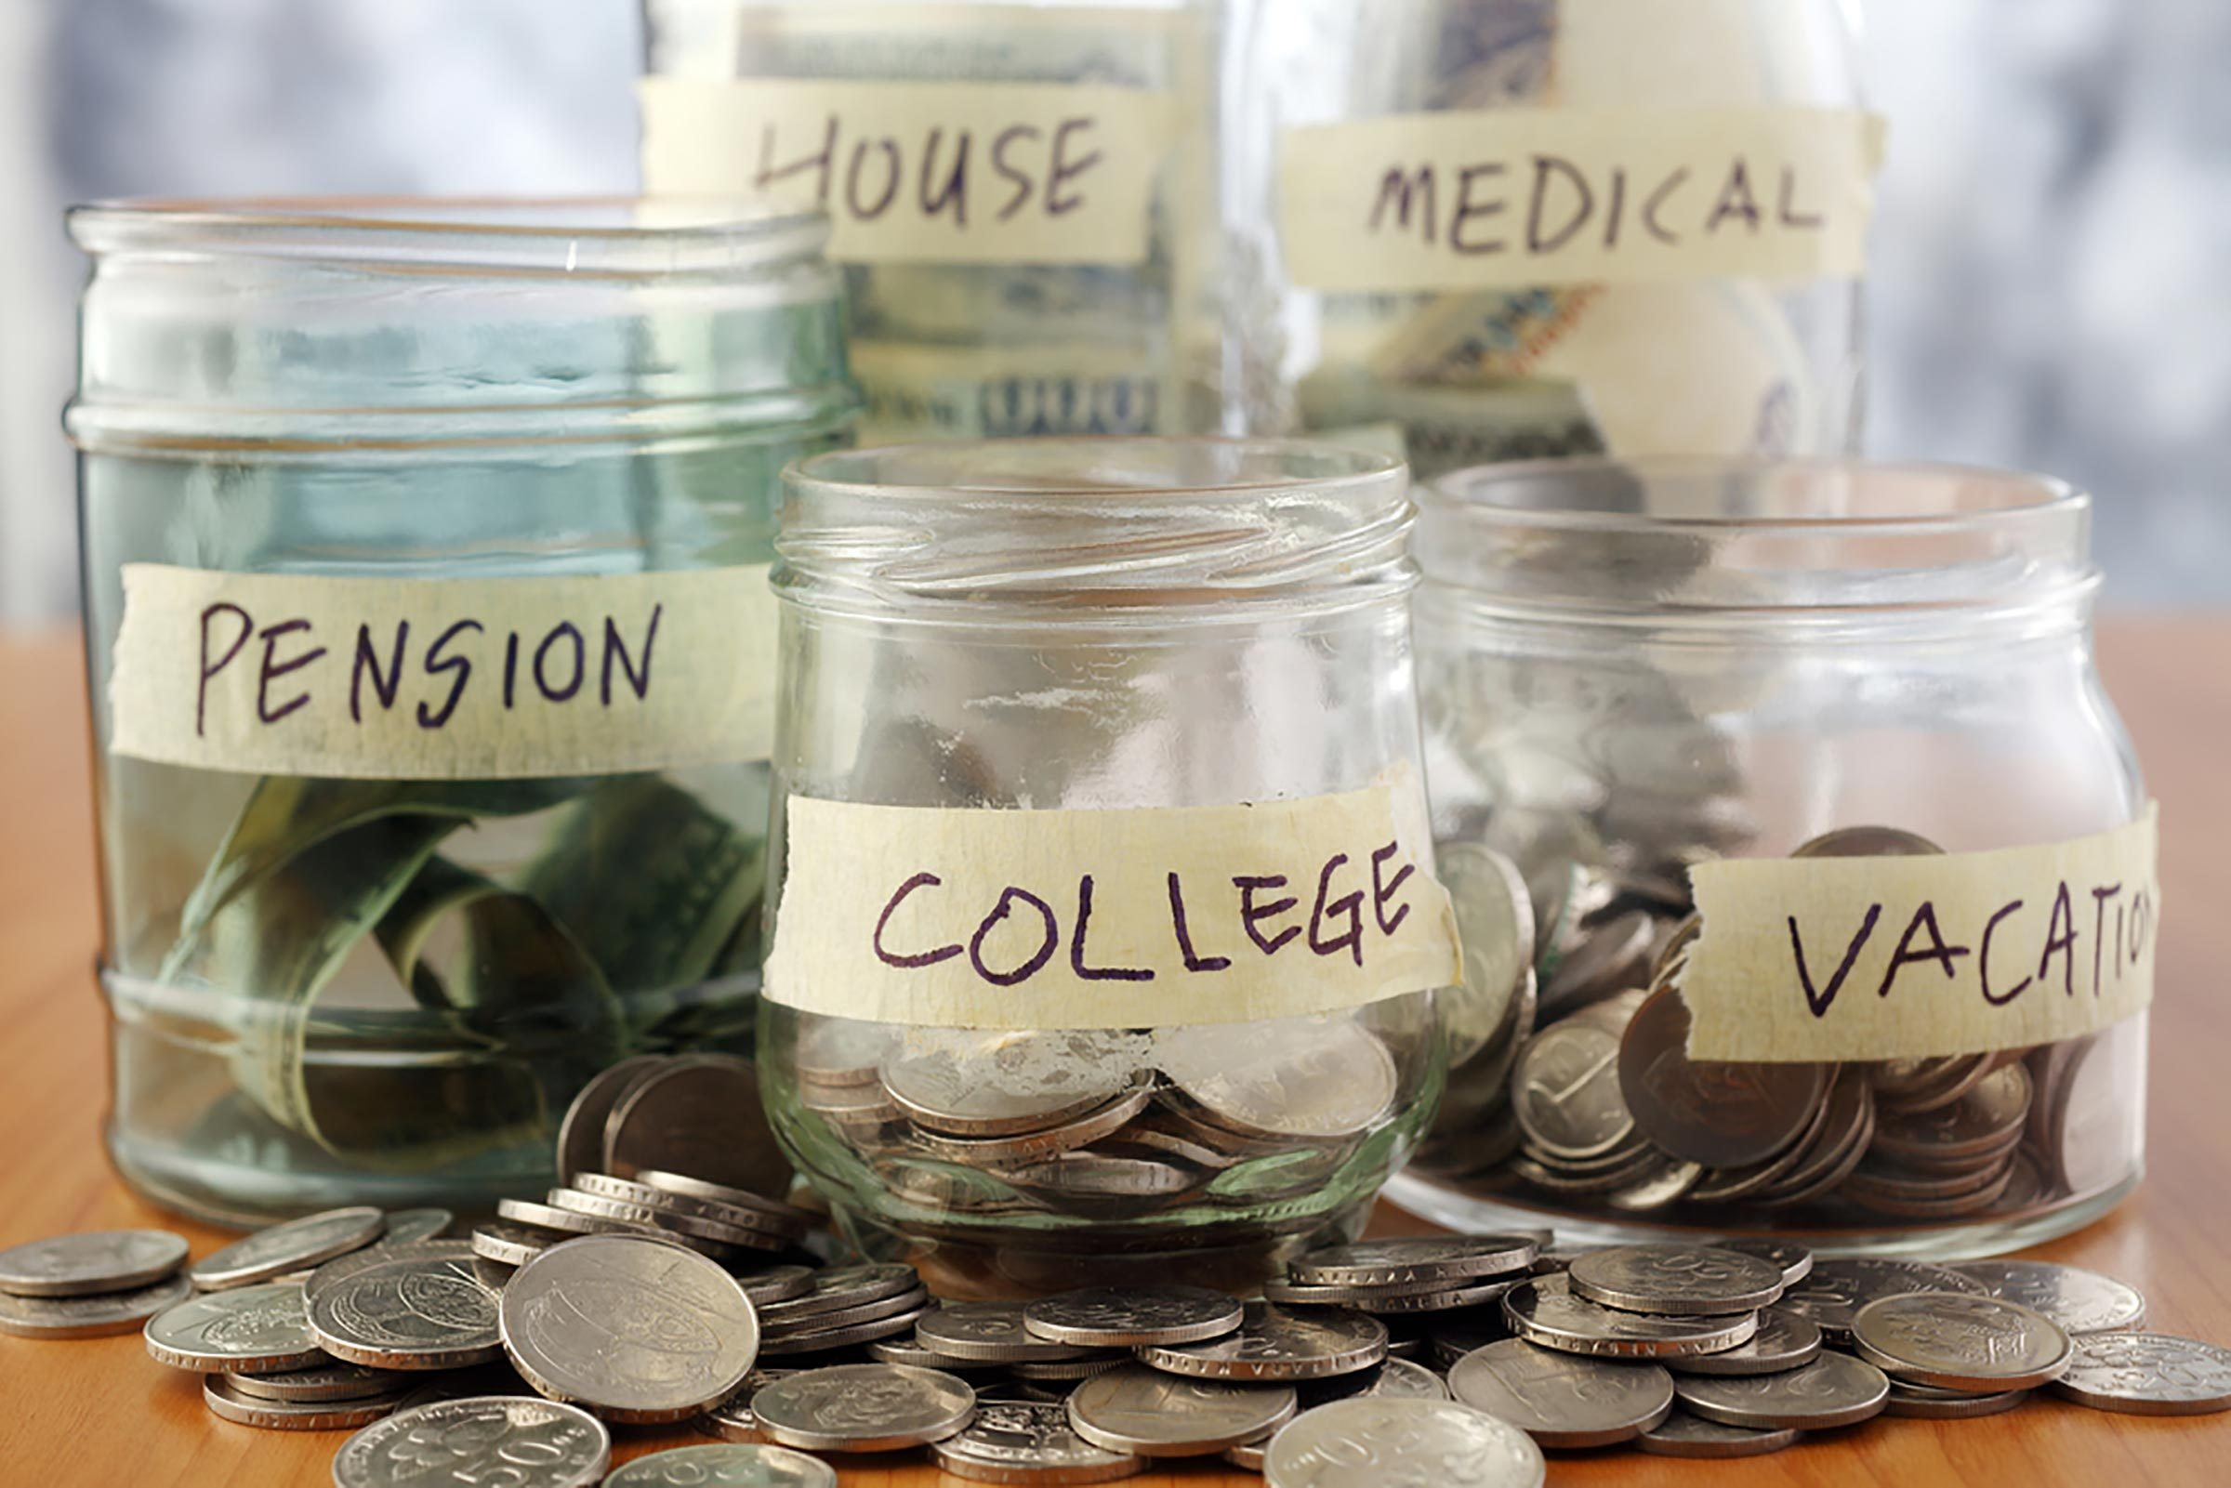
CLASS 2: How to Make more money, Save more
money and Plan for Taxes

Slide 3

How to resolve to save more money
What do you learn about saving money while growing up?
What did you observe or what where your thoughts about money while growing up?
How does it make you feel when you spend money? Is it good? Is it bad?
What are your strengths? What are your weaknesses?
It is a good idea to identify your weak areas. Once you start recognizing the weak areas in your finances, you can start to develop a plan.

Slide 4

Are there reasons or patterns you are always broke?
Maybe your bills aren’t spread out evenly enough throughout the month. It hurts when the majority of a paycheck gets absorbed by bills, leaving you with not much for yourself until the next pay period. If you notice all your bills are close in due dates, call and ask to change the billing cycle so your cash flow is more efficient.

Slide 5

Are there psychological reasons you're overspending?
Maybe you'll come to realize that you spend a lot of money on Sundays as a way to deal with the fact that you hate going into work on Mondays or to hang out with friends after church. There is psychology attached to our spending. It is a good idea is to track how your purchases are rooted in psychology. Keep a journal of how you feel when you spend money. Doing a personal finance audit might also help you understand why you spend money the way you do.

Slide 6

Are you wasting a lot of money?
That daily cup of coffee has become the poster child of wasted money – but if you’re drinking and enjoying it, is it really a waste? If you notice subscriptions that you no longer derive much pleasure from – such as a barely used gym membership – those may be worth removing from your budget.

Slide 7
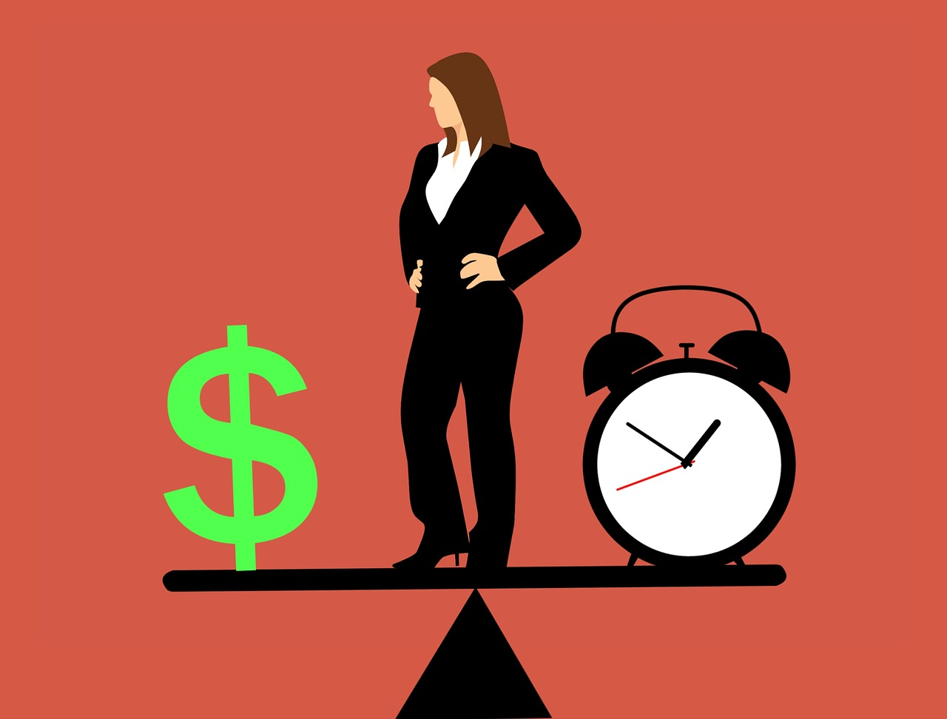
Are you doing everything perfectly?
Well, it’s possible. It won't help you if you're too easy on yourself and don't look for genuine areas in your spending where you could improve. Maybe you’ve already trimmed all of the fat out of your budget. In that case, it may be time to ask for a raise or try to change careers.

Slide 8

Make sure to spend money on fun stuff.
Life isn’t all about budgeting and saving money for retirement. While getting your financial ducks in a row is important during a personal finance audit, it’s also important you reward yourself for staying on track. Consider building a vacation fund into your monthly spending budget. Once goals and obligations are met, a reward may be necessary to keeping your morale up. Setting rewards can also help you to continuously keep your finances in check.

Slide 9

Tips for Saving Money
& Cutting Costs

Slide 10
Cook at home
Plan meals, buy groceries in bulk, cook at home, make your lunch, keep snacks with you instead of stopping for fast food. Put your cooler in the car.
Eat out less, eat out once a month, instead of several times a week.
Stop using meal delivery services
Lower grocery costs
Cut expensive name brand snacks, and processed foods. Buy food in bulk.
Shop discount stores. The 99 cents store has good fruits. Walmart is also an option. Look in papers for coupons. Shop when items are on sale. Take advantage of store reward programs.

Slide 11

Cut transportation costs
Take public transportation
Carpool instead of taking your own car or instead of Uber.
Shop around when filling your car up with gas. Do you know where the lowest cost gas station is in your neighborhood? Fill up here once or twice a week to ensure you are not stuck going to higher priced gas stations.

Slide 12

Negotiate bills
Contact cable companies, phone companies and other creditors and ask for a better rate.
Do you need an iPhone? Switch to Metro or Cricket for lower cost phone services.
If you have the internet on your phone, do you need it at home?
How many subscriptions services do you have? Do you know?
HOMEWORK: Look through your phone or your bank statement and see how many subscription services do you have? You should know where every charge on your statement is for and where it is coming from.

Slide 13
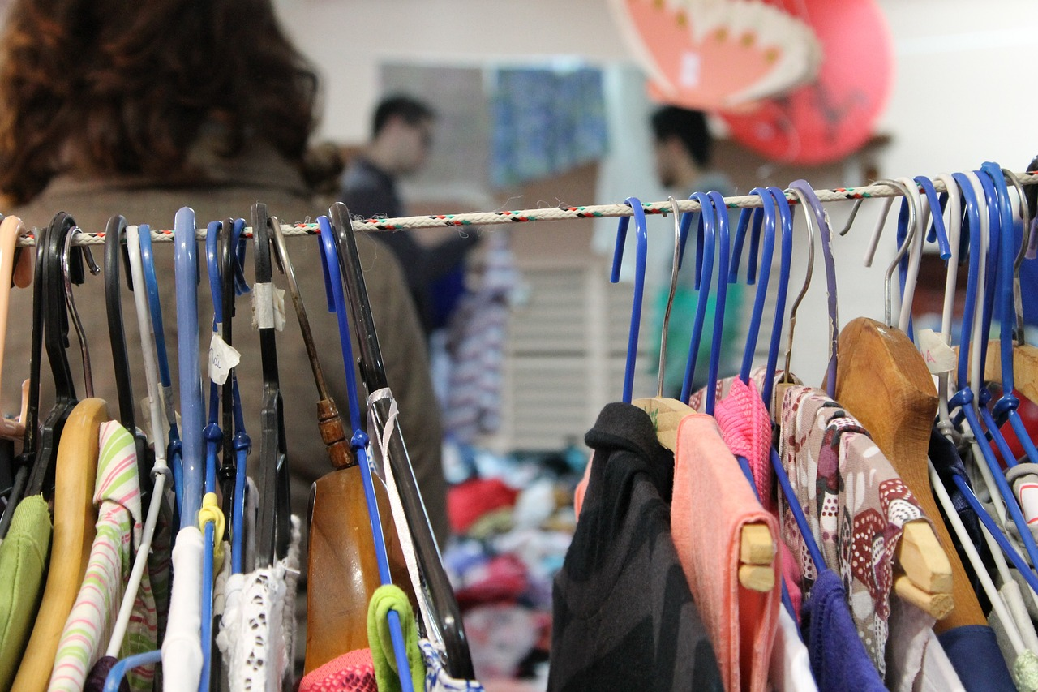
Buy secondhand or Used items
Clothing, furniture, electronics, etc. You can get really good prices on great stylish clothing, including some barely worn clothing.
Repair items instead of getting rid of them. Use iron-on patched to get more wear out of clothing. Use a needle and thread to fix buttons, and sew hems, when needed. Have the computer repaired instead of buying a new one.

Slide 14

Reduce Energy Costs
Turn off lights when not in use. Adjust the thermostat, keep the heater below 78 degrees and the air over 72 degrees. Only use heater and air conditioner when absolutely necessary.
Unplug electronics when not in use.
Reduce Housing Costs
Downgrade to a smaller place or move to a lower priced neighborhood.
Rent out a room, or a garage for storage, get a roommate. (Golden Girls)
If you need a tool, borrow it. You do not need to buy a saw if you are only going to use it one time.

Slide 15

Increase Your Income
Get a second job.
Ask for a raise.
Sale items in your home and garage. Host a yard sale. Sale on eBay, Facebook marketplace, and other places.
Create a budget and stick to it

Slide 16
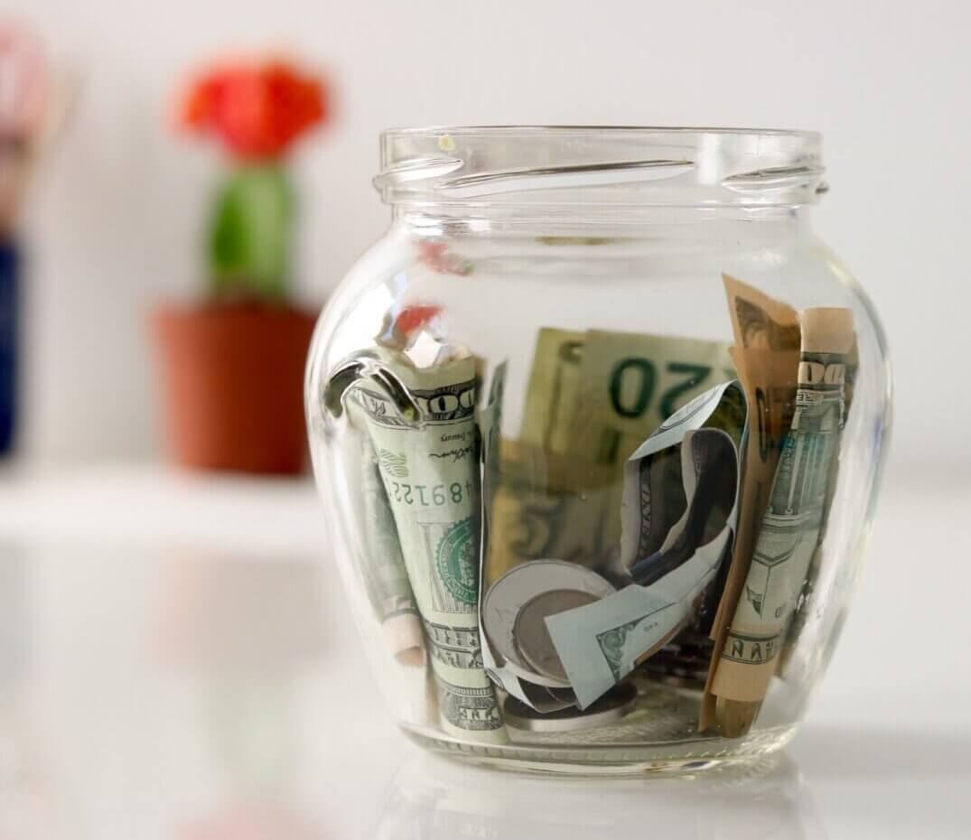
More Saving Tips: Money saving Challenges

Slide 17

Track Every Dollar You Spend Challenge
Do you know where your money is going? Take this opportunity to challenge yourself to track every dollar that you spend for a month. Thirty days should be long enough for you to track your spending, break some old habits, and possibly create some new, healthier ones.
Chances are, being aware of your spending will make you realize you need to focus on saving more and spending less.

Slide 18
No Spend Challenges: Daily, Weekly, or Monthly
Do you spend money every day?
Just the thought of not spending a single cent over the course of a week might sound difficult or even frightening to you. There are, however, many people who have successfully completed these types of challenges for a day, week, month, or more! The key is being mentally and financially prepared.
First, understand that “no spend” does not literally mean that you won’t spend any money. It realistically refers to not spending any discretionary income. Naturally, you will still pay your bills and buy groceries and essentials. Non-essential indulgences like eating out and shopping for wants must be eliminated. There is no shame in taking baby steps, if you mess up, start again. Start slow by trying to focus on having 10 no-spend days throughout a month, and work your way up until you feel comfortable going an entire week without spending on discretionary items. Perhaps every third week of each month will be your no-spend week!

Slide 19

Challenge Your Costly Habits
Do you have guilty pleasures or bad habits like defaulting to the fast food drive-thru when you feel hungry, tires, stressed, or bored? Do you toss whatever you want at the grocery store into your cart, without checking prices? Do you spend a little too much on alcohol?
Decide to challenge these habits by replacing them with the new ones. Try planning out your meals in advance, do a search on google for coupons and sales items. You can also purchase items in bulk. These will help you save on groceries and eating out. Try not to purchase alcohol when going out. Clubs, bars, movies and restaurants are always more expensive. When you finally have new saving habits firmly in place, do not forget to make them stick. Automate your savings with direct deposit or auto transfer at the bank. It is a great method for sticking with your goals to save more.

Slide 20
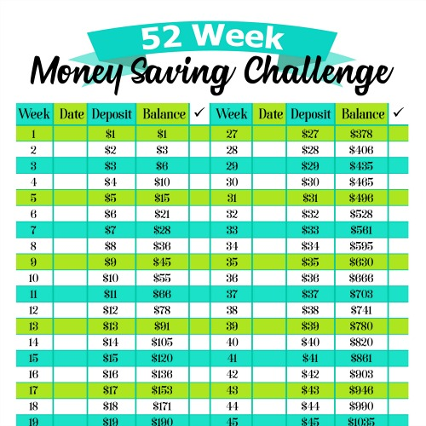
The classic 52 Week Savings Challenge
This challenge is fairly simple. If you haven’ heard of this challenge before, you save $1 the first week, $2, the second week, $3 the third week, all the way up until you hit $52 in the last week. This will give you a total of $1,378 at the end of 52 weeks from being disciplined enough to save small amounts of money each week. There are plenty of apps for timed savings challenges to help you keep track of your deposits. These include a few where you can save any amount at any point, for example saving $52 in the first week. There is also a challenge where you save $20 every week for a year which will give you a total of $1,040. These challenges can be started at any time during the year.

Slide 21
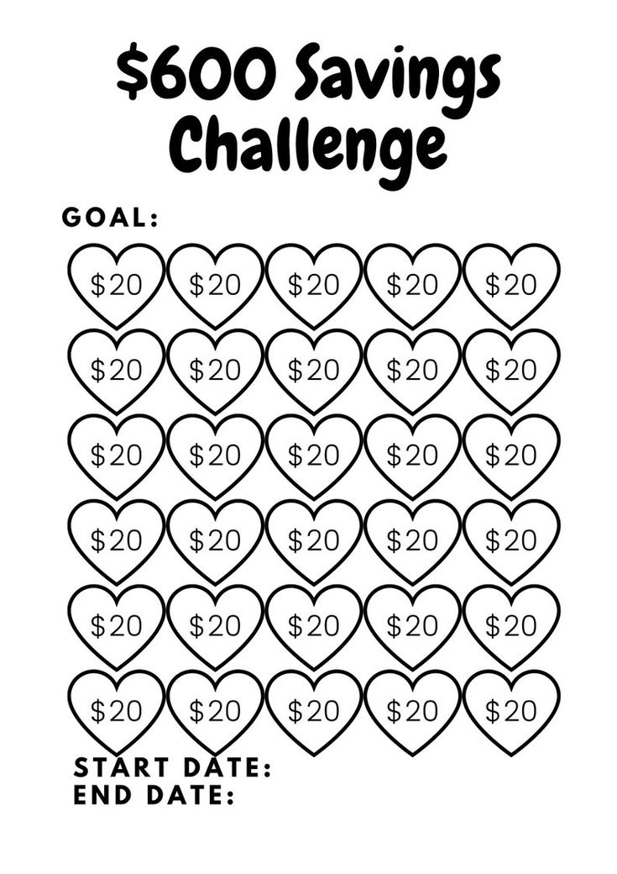
There are a number of challenges to choose from. Choose one that appeals to you and dive right in. Try to find a group, family members, or friends to do this with, and you can help hold each other accountable. Having the support of family and friends can really help.

Slide 22
Thank you for participating in the Modern Money Mastery
Financial Literacy Course
Find more videos on our youtube page at:
YouTube/@helpmehelpuLB
www.helpmehelpu.org

